Slide 1
Customising a webpage
Lesson plan
16/10/2019

Slide 2
Learning objectives
You must be able to:
Describe the use of both CSS files and HTML files
You should be able to:
Create the skeleton of a webpage
You may be able to:
Customise a CSS file to make a website look how you’d like

Slide 3



Real website designs

Slide 4
Main aspects of a website
HTML:
HTML or Hypertext Markup Language is the bare bones of a website, the layout, the structure and more come down to this language
CSS:
CSS or a Cascading Style Sheet is the base looks of the site, it acts as the skin of the page. The colour the size and more is down to CSS.
JavaScript:
JavaScript acts as the organs, a carousel is down to JavaScript. It makes the pictures change and the timing all falls down into this language

Slide 5
Ways of customising a website
There are multiple ways of creating and customising a website. The industry of web is cluttered with work arounds. In today's age many people tend to use websites to create websites such as wix or wordpress. The original way to make websites was with knowledge and an IDE, html can be created in Notepad which is a standard installed windows program. Html, css and JavaScript are all able to be made in notepad making it available for all to program in.

Slide 6
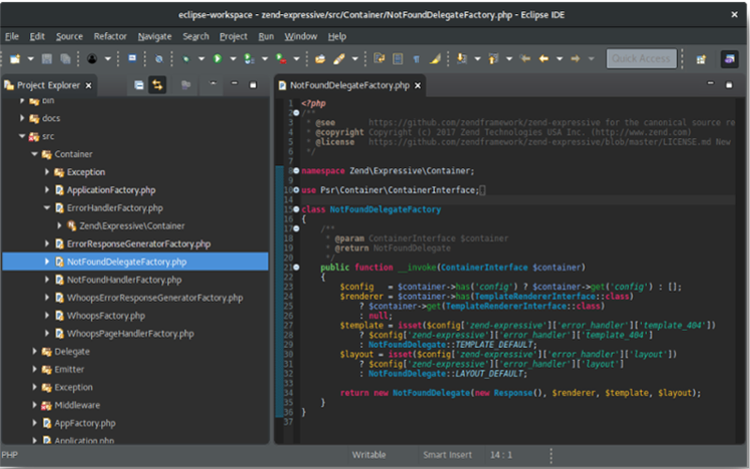
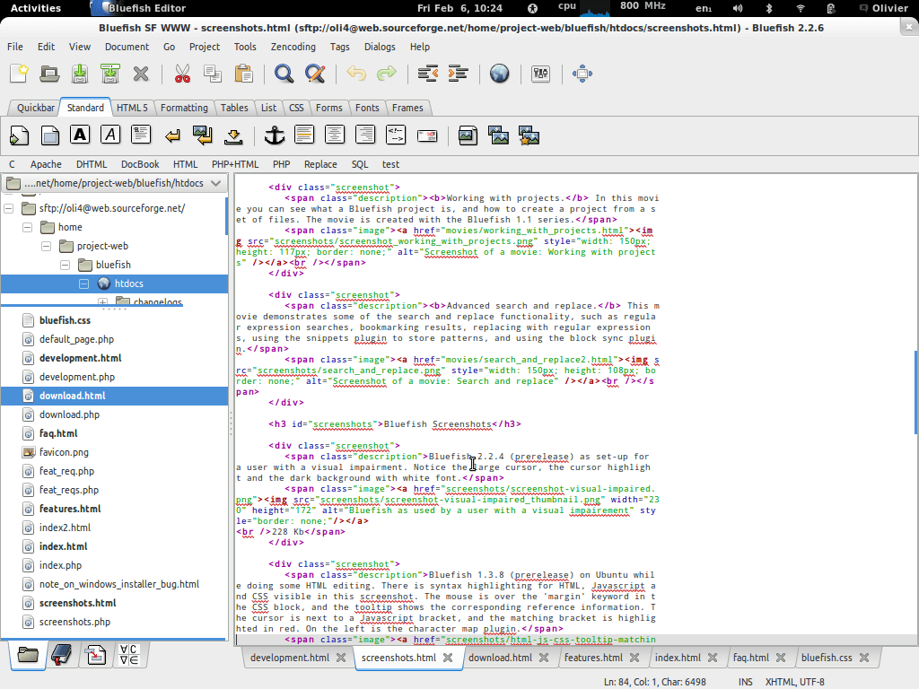


Difference of IDEs

Slide 7
Lesson Supplies
Please go to this google drive link:
https://cutt.ly/OeaF5p2
Download the zip file with in and unzip it in your documents.
Await further instructions. Please.

Slide 8
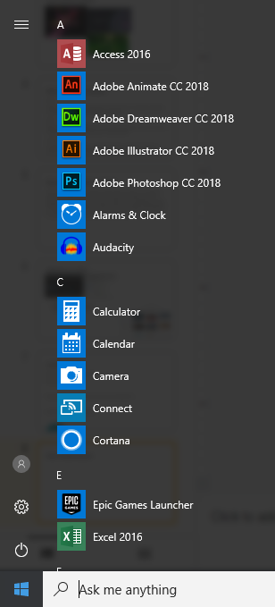
Open Dreamweaver

Slide 9
Explanation of files given
The files you've been given include a file with the bare bones of a webpage in and a css file which is blank
The page has nothing on it, the page is just a blank template with a title, head and body.
From this bare file we are going to add a few “div”s and or images

Slide 10

Adding a DIV
Adding a div is extremely simple, in the html file given simply type this:
Where it says “name” choose your own title for this div.

Slide 11
Adding an image to a DIV
When adding an image it's just as simple as telling the image to be in the div. Using this line of code will put an image in your div:
Where it says “image” after src, put the file path of the image, if you placed the image in the same folder as the page and css, then you only need to put the name and file type, for example “image.png”

Slide 12
The CSS of a DIV
There are many different values that you can customize about a div in css, the common ones are width, height, background-color and much more.
An easy way to find out what values you can change is by going to w3shcools and looking at div css
Try changing the width and height like this:
height: 100px;
width: 100px;

Slide 13
Thanks for listening

